Slide 1



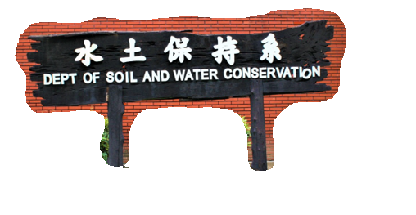
The role of vegetation in the environment
Chih-Wei Chuang
Department of Soil and Water Conservation
National Pingtung University of Science and Technology

Slide 2
Outline
The history of vegetation engineering in Taiwan
Definitions and Subjects of Vegetation
Conservation Functions of Vegetation
  Environmental Adaptation Functions of vegetation
  Soil and Water Conservation Functions of Vegetation

Slide 3
The history of vegetation engineering in Taiwan
In early years:
Taiwan’s soil and water conservation and vegetation works are scattered in pit and trench stability and landslide site remediation projects, with the utilization of germination stake nailing or staking and burying branch method to stabilize slope surface.
In the 1960s:
The main work focus that agricultural land soil and water conservation, coverage and grass cultivation, etc.
In the 1970s:
vegetation
when constructing Zhongshan Highway, a lot of foreign vegetation equipment, information, materials, and construction operational methods were introduced to carry out roadside slope stability with vegetation engineering.

Slide 4
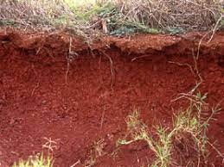
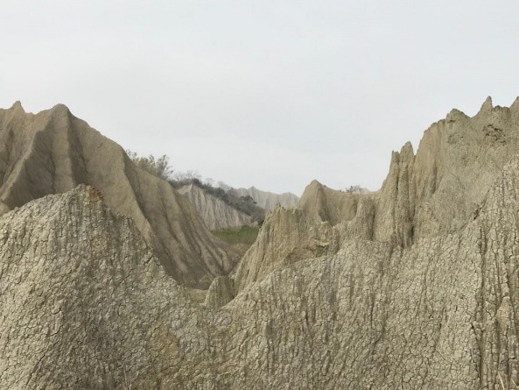
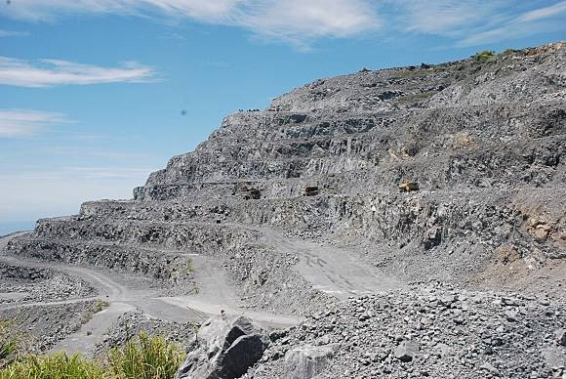
The history of vegetation engineering in Taiwan
After 1983:
Vegetation technologies for special areas including red soil, mudstone and limestone mining areas, etc. were respectively experienced and explored.

Slide 5
The history of vegetation engineering in Taiwan
In 1984:
The Greening Implementation Team was established by the Taiwan Provincial Government at that time to promote environmental greening of roads, school campuses, factories and home environments.
After 921 Earthquake in 1999:
In response to the greening and revegetation needs of wide areas of the country, ecology-based and safety-oriented ecological engineering as well as soil and water conservation vegetation works were confirmed as development direction to promote national land disaster prevention and revegetation task.

Slide 6
The history of vegetation engineering in Taiwan
In recent years :
Due to the disasters and the impacts brought on by climate change, soil and water conservation work has promoted rural green vegetation resource and environment survey, encouraged extensive planting of trees, and constructed green belts with ecological and buffering functions as performing direction.

Slide 7
Definitions and Subjects of Vegetation
Vegetation refers to the total aggregation of plants grown in an area, especially the grasses, ferns, and higher plants such as shrubs and trees, etc. grown on the ground surface.
The vegetation of soil and water conservation field focuses more on the artificial importation of vegetation materials or artificial assistance of vegetation succession, as well as accelerating the establishment of vegetational structures that have slope disaster prevention, environment conservation and sustainability functions. It consists of five parts:
  Water conservation, ground erosion prevention
  Shallow layer collapse prevention
  Flood reduction
  Air purification
  Environment beautification

Slide 8
Definitions and Subjects of Vegetation Engineering
Vegetation engineering refers to the engineering methods and technologies designed for the purpose of vegetation through selecting vegetation materials suitable for growth, coordinating with the constructive foundation and protective engineering, and then carrying out with vegetative introduction construction and operation.
The scope of vegetation work includes as:
Vegetation preparing operation (vegetation base work)
Vegetation introducing operation (vegetation practices)
Vegetation maintenance and management, etc.
These three parts are the core scopes of vegetation engineering.

Slide 9
Conservation Functions of Vegetation
1.Environmental adaptation functions of vegetation
Microclimate adjustment
Air purification
Noise control
Traffic guidance
Water purification
Biological habitat creation
The vegetation structure can influence the sun's radiation effect on the ground.
Plants can block direct sunlight and reflected
light, reduce wind speed, adjust summer
through
atmospheric temperature
evapotranspiration and energy consumption, and then adjust the microclimate and alleviate the ground temperature difference.
In addition, the temperature changes inside and outside the forest can even promote better airflow and create a more comfortable environment.

Slide 10
Conservation Functions of Vegetation
1.Environmental adaptation functions of vegetation
Microclimate adjustment
Air purification
Noise control
Traffic guidance
Water purification
Biological habitat creation
When plants breathe, they can absorb part of polluted gases into leaves, and then return them to the land via fallen leaves.
So vegetation has air purification functions of oxygen supplementation, filtration, deodorization, absorption, and suction, etc.

Slide 11
Conservation Functions of Vegetation
1.Environmental adaptation functions of vegetation
Microclimate adjustment
Air purification
Noise control
Traffic guidance
Water purification
Biological habitat creation
Plants have the effects of absorption, reflection, refraction, and deflection on noises, so they can effectively reduce the noise pollution of the environment.
In particular, the establishment of green buffer strips or buffering belts around the development base can effectively control noise.

Slide 12
Conservation Functions of Vegetation
1.Environmental adaptation functions of vegetation
Microclimate adjustment
Air purification
Noise control
Traffic guidance
Water purification
Biological habitat creation
The application of vegetative green belts, green fences, or the planting of forest belts can effectively reduce glare interference.
Design should avoid vegetation plants prone to
cause glare, and provides passersby with a
comfortable traffic environment.
The street trees on the road and the green belt on the refuge island can also reduce the wind speed
to adjust the microclimate and maintain the driving safety.

Slide 13
Conservation Functions of Vegetation
1.Environmental adaptation functions of vegetation
Microclimate adjustment
Air purification
Noise control
Traffic guidance
Water purification
Biological habitat creation
The vegetation protection green belts set on the edges of natural rivers, stream areas, agricultural ponds or wetlands have the functions of stabilizing the waterfront, filtering sediment, and filtering pollutants in water purification.
The construction of good forest form and vegetation cover in the water resource protection zone stabilizes and provides excellent water quality.

Slide 14
Conservation Functions of Vegetation
1.Environmental adaptation functions of vegetation
Microclimate adjustment
Air purification
Noise control
Traffic guidance
Water purification
Biological habitat creation
The plant community having multi-layer canopy covers can provide plenty of foods, supply material energy circulation and create habitats for wild animals, and also provide places for people to relax or play.

Slide 15
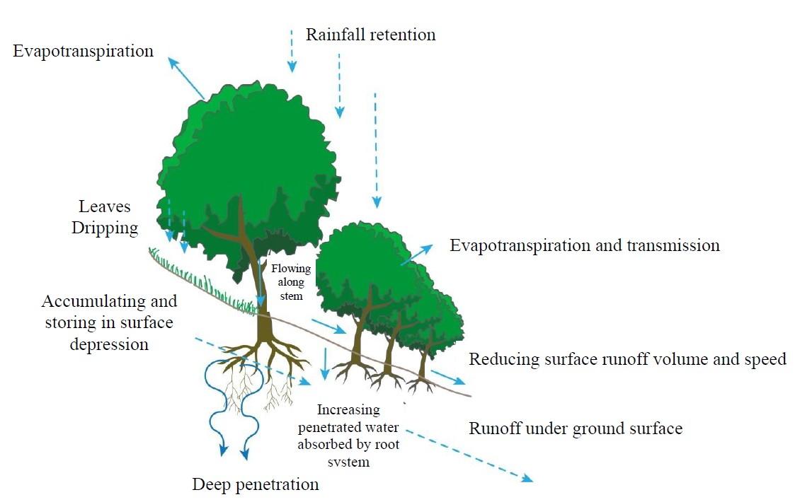
Conservation Functions of Vegetation
Soil and Water Conservation Functions of Vegetation
  Water conservation function of vegetation
    The interception effect of crown canopy
The crown canopy of trees can intercept rainfall and reduce the volume and rate of rainfall reaching the ground surface. In areas with better forest vegetation coverage, about 30% of the annual rainfall can be intercepted. For a single rainfall, the canopy interception rate can reach 100% when the rainfall is small. When the rainfall is heavy, it can reach about 25%.(Lin Xinhui, 2004). The canopy interception volume or rate is affected by tree species, tree age, degree of crown closeness, branch shape, bark roughness, and leaf shape characteristics.

Slide 16
Conservation Functions of Vegetation
Soil and Water Conservation Functions of Vegetation
  Water conservation function of vegetation
(2)Ground surface protection
Vegetation cover can prevent soil separation and loss due to raindrop impact. Through the protection of vegetation, surface hardening can be effectively prevented, and soil aggregate stability and infiltration rate can be increased. In general, plant coverage rate will affect the degree of resistance to the impact of rainfall. In the regions with the vegetation coverage rate of less than 70%, the runoff rate and erosion amount will rapidly increase due to the reduction of vegetation coverage. (Lin Xinhui, 2004).

Slide 17
Conservation Functions of Vegetation
Soil and Water Conservation Functions of Vegetation
  Water conservation function of vegetation (3)Increase of infiltration effect
    The presence of horizontal root system and its above-ground backbone of plant’s root base protruding from ground and dead branches, can increase ground surface roughness, and can extend the retention time of rainwater on the surface and increase the infiltration volume.
    The topsoil forms a lower bulk density and a better aggregate structure, which can increase soil water preserving ability.
    The crown canopy layer and the litter layer of plant can delay the time when the rain falls to ground surface, which can effectively increase the infiltration amount.

Slide 18
Conservation Functions of Vegetation
Soil and Water Conservation Functions of Vegetation
  Water conservation function of vegetation
    Runoff mitigation
      Plant canopy intercepts rainwater and reduces rainfall in the forest.
      The litter layer and the ground cover plants have the function of absorbing rainfall moisture.
      The soil under the litter layer is beneficial to the infiltration of runoff water into the soil due to the increase of humus and the aggregate structure and the residual pores of the corroded root group.
      Plant roots can improve the properties of deep soils and increase soil water preserving and infiltration abilities.
      The root systems of vegetation cover are particularly intertwined, reducing the
development of surface erosion and gully.

Slide 19
Concept and Design of Vegetation Engineering
Chih-Wei Chuang
Department of Soil and Water Conservation
National Pingtung University of Science and Technology

Slide 20
Outline
Key Items of Vegetation Engineering Planning
Basic Types of Vegetation Engineering Design Objectives
Site Conditions and Corresponding Strategies of Vegetation Engineering
Base Site Conditions and Vegetation Engineering Treatment
Guest Soil

Slide 21


Key Items of Vegetation Engineering Planning
When planning a vegetation engineering, it is necessary to first establish the expected goal of the vegetation engineering, so as to develop a vegetation engineering plan. When studying and developing, it should consider as follows:
Vegetation pre-operation works,
Vegetation introducing operation,
Vegetation maintenance and management.
Pre-operation works
Vegetation Engineering
Core works
Introducing operation
maintenance and management

Slide 22
Key Items of Vegetation Engineering Planning
1.Vegetation pre-operation works
Define:
Refers to the engineering protection measures done before introducing vegetation in exposed slopes.
Goal:
To aim at reducing soil erosion, stabilizing slope, preventing the expansion of collapse area, enhancing the stability of slope foundation, and creating the environmental conditions helpful to the germination, growth, and succession of plants. When plants are introduced into slope, the premise is that the gradient and erosion control of the base, physicochemical properties of the soil matrix, and the climatic conditions must be suitable for the growth and establishment of the target plant community.

Slide 23
Key Items of Vegetation Engineering Planning
Vegetation introducing operation
Refers to the suitable operational methods used to enable plants to proliferate and grow on the base according to slope conditions and the purpose of vegetation. The methods of vegetation introducing operation can be roughly divided into seeding method, transplanting method and vegetation induction method.
Vegetation maintenance and management
Refers to the measures required to ensure the effectiveness of the vegetation engineering.

Slide 24
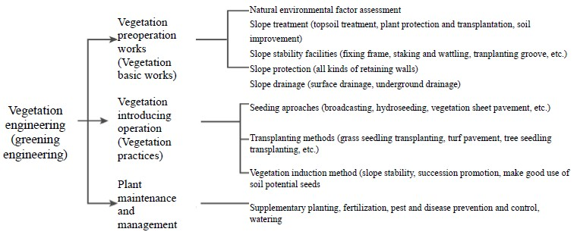
Key Items of Vegetation Engineering Planning
Schematic diagram of the work items of vegetation engineering

Slide 25
Basic Types of Vegetation Engineering Design Objectives
Soil and water conservation type
The rapid vegetation covering method used in artificial development, vegetation destruction areas or exposed areas of natural disasters for the purposes of soil and water conservation, erosion reduction, disaster prevention, etc., Better effectiveness can be achieved if cooperates with soil and water conservation engineering.
Landscape green land type
Cooperating with artificial structures to carry out vegetation introducing operations. In principle, local plants and landscape plants are mainly used to create green land space and landscape beauty.

Slide 26
Basic Types of Vegetation Engineering Design Objectives
Nature conservation type
Natural plant succession to reach vegetation communities near its apogee with the use of native plants as principle, in order to restore the status of the existing vegetation, usually is used in natural forest park or conservation area.
Coordinating afforestation type
Mainly for forestry operation and management, reach artificial forest community in short term through the transplanting of economic forest tree species and artificial tending. Tree seedling and small seedling transplanting is often used to ensure that trees (roots) grow normally and the goal can be achieved with more economic operation.

Slide 27
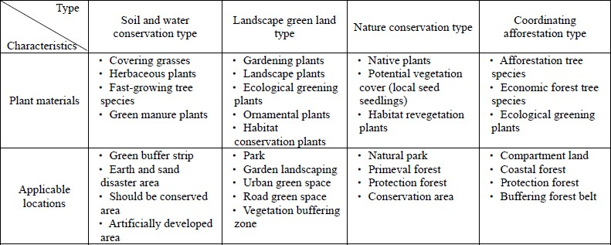
Basic Types of Vegetation Engineering Design Objectives
Comparison of basic design types of vegetation engineering (Source: Soil and Water Conservation Handbook, 2005)

Slide 28
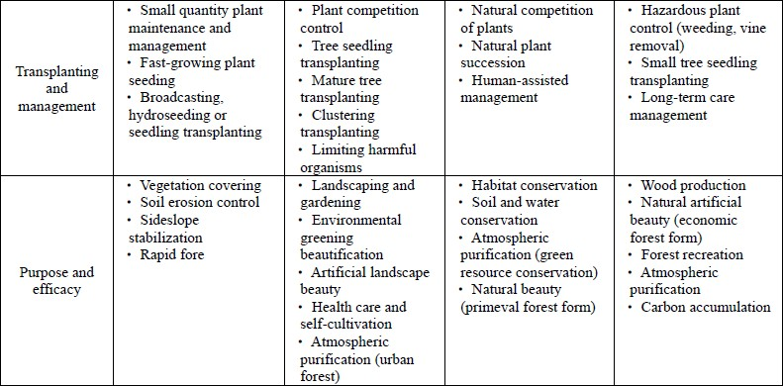
Basic Types of Vegetation Engineering Design Objectives
Comparison of basic design types of vegetation engineering (Source: Soil and Water Conservation Handbook, 2005)(Continued)
Rapid forest

Slide 29
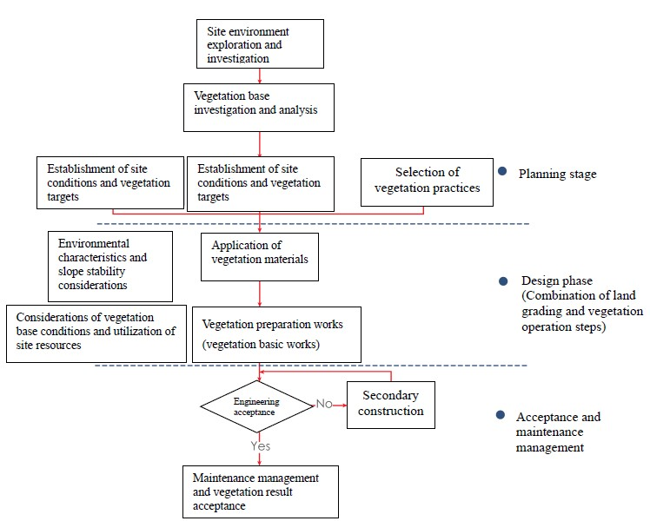

Application of vegetation materials
Vegetation preparation works (vegetation basic work)
Vegetation introducing works
Vegetation engineering plan flowchart

Slide 30
Site Conditions and Corresponding Strategies of Vegetation Engineering
Plant growth is affected by the surrounding environmental conditions, including as follows:
climatic factors
(sunlight, atmospheric temperature, rainfall, strong winds, etc.),
soil factors
(effective soil depth, physical properties of soil chemical properties of soil)
terrain and geology (gradient), etc.

Slide 31
Site Conditions and Corresponding Strategies of Vegetation Engineering
climatic factors
  Sunlight
Plants need plenty of sunlight to thrive, under strong light conditions the plants robustly growing and developed are called sun plants. Sun plants usually have the ability to withstand high temperature and drought, and they have the pioneer plant characteristics that are fast grow in early period and can firstly develop on exposed ground and survive.
  Atmospheric temperature
The atmospheric temperature is affected by latitude, altitude, wind and
terrain and topography, but when the latitude is similar, the altitude is an important factor affecting atmospheric temperature.

Slide 32
Site Conditions and Corresponding Strategies of Vegetation Engineering
climatic factors (Continued)
C. Rainfall
Due to the interaction of monsoon and topographic factors, Taiwan has abundant rainfall. The average annual rainfall is about 2500 mm, but the rainfall is unevenly distributed. In the absence of rainfall, vegetation must choose drought-tolerant plants, otherwise plants will be stunted or die due to lack of water.
D. Wind
Drying effect: Moisture can be blown away from the surface of plant leaves, promoting evapotranspiration, which can lead to dry leaves and closed stomata, reducing the effectiveness of photosynthesis.
Mechanical effect: Plants would have the situations such as ruptured leaves, broken branches and causing flag and compression wood if they were blown and attacked by strong winds. Shallow rooted trees are easy to fall or incline because of the effect of wind.

Slide 33
Site Conditions and Corresponding Strategies of Vegetation Engineering
Soil texture
In addition to affecting the maintenance and supply of nutrients and water, soil's physical properties also affect the development and distribution of system roots and the activities of microorganisms. When soil is in the natural state, its physical properties are very important to plant growth and soil fertility, in addition, the permeability rate and water preservation of the water conserved in the forest are also affected by the physical properties of the soil.

Slide 34
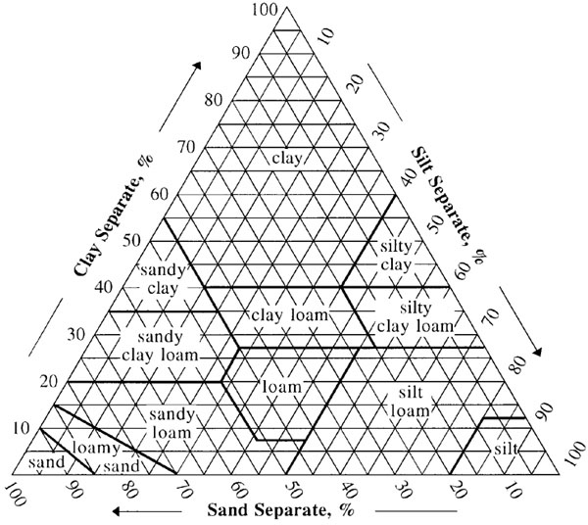
Site Conditions and Corresponding Strategies of Vegetation Engineering
There are several soil physical properties that affect plant growth.
Soil stone content
Soil hardness
Combination of three phases of soil
Soil texture
soil texture triangle

Slide 35
Site Conditions and Corresponding Strategies of Vegetation Engineering
Soil chemical properties
  The chemical components of the nutrients required for plant growth in the soil include content, proportion, and properties, these are collectively referred to as chemical properties of soil. To maintain good plant breeding, needs the fertilizer three elements nitrogen, phosphorus, and potassium, coupling with calcium, and magnesium, the total five elements are most important.
  The availability of the contents of these elements in the soil is comprehensively affected by soil reaction, water, and proportions of the amount of each element, therefore, when determining whether the plant nutrients are rich or not, must be evaluated from the overall chemical properties composition of the soil.

Slide 36
Site Conditions and Corresponding Strategies of Vegetation Engineering
Soil chemical properties (Continued)
  Soil pH value
The soil solution often contains H+ and OH- ions, and the content of the two varies depending on soil type, which makes the soil acidic, neutral and alkaline, and is usually expressed by pH value. The large or small of pH value is related to whether nutrients can be absorbed and utilized by plants. Too high or too low pH value may cause toxicity caused by certain nutrients. In general plants prefer to grow in the soil environment with a pH value of about 6.5.

Slide 37
Site Conditions and Corresponding Strategies of Vegetation Engineering
Soil chemical properties (Continued)
  Soil nutrients
Deficiency or excess of soil nutrients will affect plant’s growth, which may occur in the symptoms are described as follows:
    Nitrogen fertilizer: When it is lacking, the leaves will become a unclear yellow to green; when excessive, the leaves will be in dark green, the leaves will be juicy and soft, and the flowers will be delayed and fruits will be less.
    Phosphate fertilizer: When it is lacking, the cell division is declining, the plant is poorly developed, the leaves are narrow, and the old leaves appear red; when excessive, leaf flesh is thick and the trunk is short, the root grows poorly, fruit is excessively mature and yield reduces.
    Potassium fertilizer: When it is lacking, the planting stock is short, the tip of the leaf is brown, and in severe cases, gangrene is produced; when it is excessive, the new leaves tend to become larger and the planting stock is elongated and the growth energy is weak.

Slide 38
Base Site Conditions and Vegetation Engineering Treatment
1. Side slope gradient
Required coordinating engineering treatments when conducting vegetation on different gradients (Source: modified from Yoshinari Yamadera, 1988)
Gradient | Vegetation growth situation | Coordinating engineering treatment
Below 35° | Plants grow well. Plants naturally invade and generally grow well. May restore to arbor-based plant society. | Mainly based on drainage and slope treatment measures. Can apply vegetation treatments such as turf pavement, vegetation sheet pavement, hydroseeding, etc. Carry out vegetation treatment after simple foundation works of trench diggings and slope drainage

Slide 39
Base Site Conditions and Vegetation Engineering Treatment
Gradient | Vegetation growth situation | Coordinating engineering treatment
35°~45° | The main plant communities are shrubs and herbs. Transplanting arbor is dangerous and easy to incur the instability of the breeding base. If the gradient exceeds 35°, the plants’ naturally invasion and breeding are slower. | Vegetation after simple basic engineering treatment. Retaining wall, retaining fence, staking and wattling, wire cylinder slope protection, digging planting pits, etc. Net paving and hydroseeding, shaping frame, etc.
45°~60° | The main plant communities are shrubs and herbs. 45°~50° is the critical gradient of planting arbor. Slope stability is difficult, and the terrace surface of the whole slope is coordinated with transplanting plants. | Fixing frame, retaining wall. Laying 3D net, composite net coordinated with guest soil hydroseeding.
More than 60° | It is not easy to transplant plants or natural invasion and growth are difficult. | Retaining wall, free beam frame. Setting buffering belt or rockfall prevention measures.
21

Slide 40
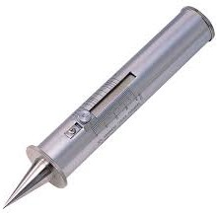
Base Site Conditions and Vegetation Engineering Treatment
2. Soil hardness
The measured value of Yamanak a hardness tester is usually used as standard of indicator of soil hardness. The Yamanaka hardness tester has a length of 23cm, a diameter of 5cm and a weight of 0.65kg. When inserting the tip of the cone into the soil, then the retraction length of the spring contained inside, which is of 8kg resistance strength, is the measured value of the soil hardness tester.
The Yamanaka hardness tester

Slide 41
Base Site Conditions and Vegetation Engineering Treatment
Principles of vegetation engineering treatment methods for different soil hardness
Soil hardness measurement value (H) | Plant breeding situation | Coordinated with vegetation engineering
H<10mm | The soil is soft and dry, the water preserving ability of the soil is poor, and the plants germinate and grow poorly. When the slope is not treated or is larger than the resting angle, it is easy to fall. | Measures for preventing drying such as covering with straw mats. Fixing frame and guest soil vegetation. Covering with straw mats after seed spraying.
10~20mm | The roots stretch well. Seed germination and growth are good. | Woody plants can be planted. Vegetation methods such as hydroseeding method, vegetation sheet, soil bag, net paving and guest soil hydroseeding can be used.

Slide 42
Base Site Conditions and Vegetation Engineering Treatment
Soil hardness measurement value (H) | Plant breeding situation | Coordinated with vegetation engineering
20~26mm | The plants grow well. There may be a rapid decline in the hydroseeding of exotic grass species. | Woody plants can be planted, but the design of pit planting and guest soil volume are still needed to be strengthened. Can be coordinated with the seeding practice of applying middle layer materials.
26~30mm | Root growth is blocked or may decline rapidly. If the soil has big hole spaces , the growth of plant roots is still possible. | Improving soil hardness by drilling holes or digging trenches. Avoiding the use of the vegetation methods such as transplanting, seed broadcasting and stem burying. Better to use seed spraying after drilling holes, or paving vegetation sheet, laying ne t and guest soil hydroseeding, fixing frame and guest soil vegetation and the like after thickening guest soil.

Slide 43
Base Site Conditions and Vegetation Engineering Treatment
Soil hardness measurement value (H) | Plant breeding situation | Coordinated with vegetation engineering
H> 30mm | The plant root system is unable to invade and grow. Breeding is difficult. | Guest soil hydroseeding after drilling holes. Wire cylinder coordinated with guest soil, shaping frame guest soil vegetation.

Slide 44
Guest Soil
Definition
Guest soils refer to the soils containing rich organic matters and better physicochemical properties casted in construction site in order to improve soil conditions of vegetation environment and facilitate growth of introduced plants. The natures of guest soil materials are usually different from those of the original soil of the slope, and after improving original ground topsoil or adding organic materials, and then casting on surface as vegetation base materials, the soil properties is different from the original surface soil, this also belongs to the operational method of guest soil.

Slide 45
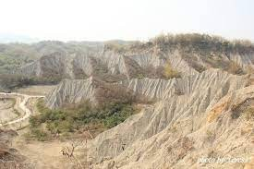
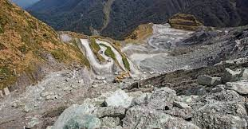
Guest Soil
Applications
In exposed area of large area slope development, slope of road cutting and filling, mudstone area or mining area, because of its innate site and soil conditions are poor, causing considerable difficulties in plant growth; in addition, seedling pit planting site or vegetation engineering construction site which needs fast growth of dense turf, also needs guest soil treatment in order to reach
expected results of vegetation.
Mudstone area
Mining area

Slide 46
Vegetation Survey and Analysis
Chih-Wei Chuang
Department of Soil and Water Conservation
National Pingtung University of Science and Technology

Slide 47
Outline
Types of Vegetation Survey
Qualitative survey of plant communities
Quantitative survey of plant communities
  Key Points for Sample Area Sampling Survey Method
  Sample Area Sampling Survey Items and Methods
  No Sample Area Sampling Survey Method
Analysis and Application of Vegetation Data

Slide 48
Types of Vegetation Survey
Purpose
The purpose of vegetation survey is to derive all clusters and their attributes of plant society within an area , study and analyze the composing individuals and their sizes , number, arrangement, etc. and mutual relationships of these plant communities , and
further conjecture
competitive situation of species, and possible succession
development of the plant society.
Category Definition
Vegetation survey often uses sample area data to conjecture the attributes of the parent population, speculate the overall characteristics of the vegetation community with fewer survey data, and use them as a reference basis. Vegetation survey categories can be summarized into flora survey and plant community survey respectively.

Slide 49
Types of Vegetation Survey
Category Definition(Continued)
1.Flora survey
Flora survey is using all plant species in a certain area as the target to conduct the collection and judgment and interpretation works of the plants, record or estimate basic data of each species, such as attributes, number of population, distribution and breeding environment, and conditions, etc., and study and analyze the characteristics such as size, number, arrangement and their mutual relationships of the composing individuals (specifically dominant species) of the plant community.

Slide 50
Types of Vegetation Survey
Category Definition(Continued)
2.Vegetation community survey
Taking vegetation community as the survey target, set up sample areas of the vegetation community in a homogeneous environment, record species, composition structure, and distribution of the plants in the survey sample areas, and investigate tree height and chest height diameter of the main dominant plants as needed for the reference of analyzing vegetation community patterns, producing vegetation diagram and vegetation community sectional diagram, and conjecturing plant succession, mutual relationships between populations. The vegetation community survey can be divided into a vegetation qualitative survey and a vegetation quantitative survey.

Slide 51
Qualitative survey of plant communities
Plant qualitative survey is to investigate the characteristics of plant society according to the degree of homogeneity and use dominant plant species as the representative of vegetation community. And it is usually done by subjective observation on the composition of a plant community to give the traits of the plant s in accordance with
the characteristics described, and afterward can indirectly understand local
environmental characteristics through the plant traits.
(1)Degree of clustering of the vegetative individuals (sociability)
The sociability of plant population refers to the degree of clustering of the individuals of the plant population , i.e., the relative gregariousness or clumping of the individuals of the plant population. The sociability can be divided into five grades as described in detail in Table.

Slide 52
Qualitative survey of plant communities
Plant population society grading table
Grade | Degree of Clustering | Growth Pattern
First Grade (soc.1) | Growing alone | Growing solitary, single
Second Grade (soc.2) | Growing in clusters | Forming clumps or dense groups
Third Grade (soc.3) | Growing in patches or cushions | Forming small patches or cushions
Fourth Grade (soc.4) | Growing in small groups | Growing in small colonies or forming larger carpets
Fifth Grade (soc.5) | Growing in large groups | Growing in larger, almost pure population stand

Slide 53
Qualitative survey of plant communities
(2) Structural (hierarchical) characteristic of vegetation community
Plant community generally has certain biological composition has hierarchies on biodistribution, and has circadian rhythm and seasonal changes, and increase and decrease phenomena in terms of time. In addition, various bio s are mutually dependent, mutually influencing, and their respective environment and biological population has a close mutual influence relationship.

Slide 54
Quantitative survey of plant communities
1. Key Points for Sample Area Sampling Survey Method
Vegetation quantitative survey method is to select appropriate sample areas in the survey region according to environment, life forms of plants, canopy structure and distribution and survey purposes and other conditions to conduct the investigation of the species, numbers and growth situations of plants, and then carry out combinatorial analysis in accordance with the parameters obtained from survey as a method for calculating the characteristics of vegetation community.
The setting of survey sample areas need to consider the area characteristic factors such as sample area shape, sample area orientation, distribution pattern of sample areas, minimum area of sample area, and minimum number of sample areas.

Slide 55
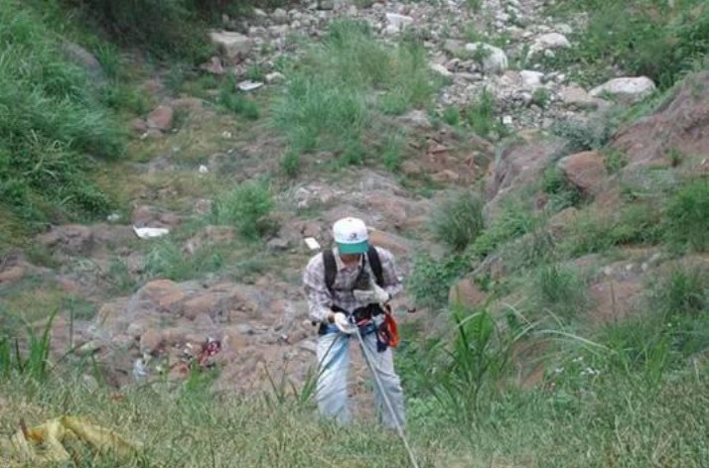
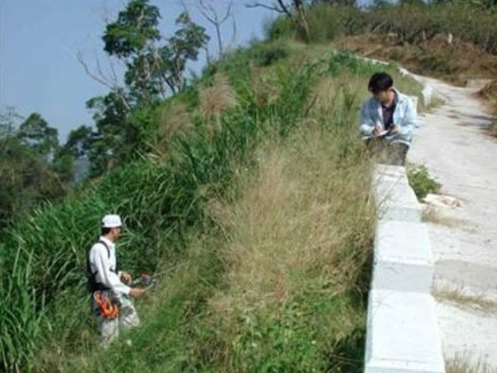
Quantitative survey of plant communities
A. Selection of sample area shape
The selection of sample area may vary depending on the terrain and the convenience of the survey. Generally, square, rectangular, strip-shaped cross-sectional areas or line-like sample area (line-intercept method) are commonly used shapes.
Source:
Catchment Area Vegetation Community Survey Application Handbook, 2008

Slide 56
Quantitative survey of plant communities
B. Orientation and distribution of sample areas
The setting of sample areas also must consider their orientation, i.e., the arrangement direction of long or short axis.
If the plant society is homogeneous, the orientation has less influence, however, in general mountain areas the flora slightly changes in gradient due to the topography, so the selection of long axis should cross the changed gradients in order to obtain accurate (smaller variation) data.
If the survey region is a large-scale vegetation community and not a single plant society, then objective synthesis method is commonly used to set sample areas, and
the obtained sample area data are classified in order to construct a mosaic structure.

Slide 57
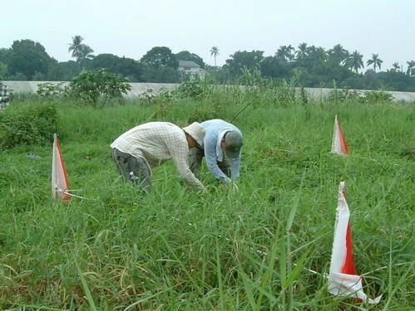
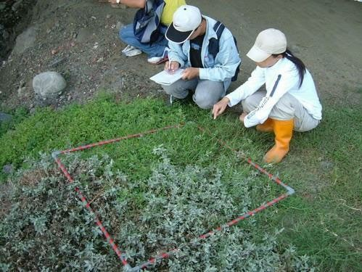
Quantitative survey of plant communities
C. Area of sample area
When conducting sampling survey, first must determine that how much the area of the sample areas should be set . In general, when selecting the area of the sample areas, in addition to considering whether the plant community composition is homogeneous, must also consider the life forms o f the vegetation community. When selecting the size of the sample areas , can choose a appropriate method to determine the size of the sampling areas according to the rule of
thumb, (Lin Xinhui, 2008). When conducting vegetation community survey , the minimum required area of sample areas is determined by the richness of plant species.

Slide 58
Quantitative survey of plant communities
Minimum area of sample area of category vegetation community survey
Vegetation community category | Minimum area of sample area (m²)
Herb layer | 1-2
Low shrub and high herb layers | 4
High shrub layer | 16(4X4)
Arbor layer | 100(10X10)

Slide 59
Quantitative survey of plant communities
D. Number of sample areas
In general, the number of sample areas must be decided by changes in vegetation community logistic time, budget and manpower etc. However, in accurate vegetation community survey , the area of the sample areas accounted for the percentage of the research region should be determined first. At the same time, should consider how many vegetation groups are seen during exploration , and each vegetation group should not only be covered at the time of sampling, but also should be repeated , because the number of sample areas will affect the accuracy of the survey. And in the determination of the appropriate number of sample areas the “species number sample area number curve” method is mostly used. This method is similar to the species number area number curve method, i.e., using the plant relationship between the number of species and the number of sample areas to conduct the plot ting, research and analysis.

Slide 60
Quantitative survey of plant communities
Sample Area Sampling Survey Items and Methods
A. Quantitative media of vegetation survey
The more commonly used parameters for quantifying vegetation community include density, frequency, coverage or dominance.
  Density
Refers to the number of plant individuals per unit area. Its calculation is usually expressed in terms of number of plants per m² or ha.
  Frequency
Refers to the number of occurrences of a certain plant in each set sample area or sample point. It is usually expressed as the ratio of the number of plants recorded in the sample area during survey to the total number of plants recorded in total sample areas set.

Slide 61
Quantitative survey of plant communities
c) Coverage
Coverage is the ratio of the projected area of canopy or branches of a plant to the area of the ground surface, often expressed as a fraction or percentage. It is usually used to
Coverage grade distinction
Grade | Coverage area percentage (%)
Grade A | Less than 5
Grade B | 6~25
Grade C | 26~50
Grade D | 51~75
Grade E | 76~100
compare the difference between the ratios of the spaces occupied by different plants within a vegetation community, and as a parameter of the dominance of plant in the breeding area.

Slide 62
Quantitative survey of plant communities
No Sample Area Sampling Survey Method
  The point intercept method is also called the point quadrat method. Its principle is when estimate the plant coverage, draw the covered profile of the plant onto a square grid paper, and then calculate the number of squares occupied by it, and the obtained result is calculated as the coverage of the plant.
  When measuring , the applicable tool is point frequency frame, this frame is usually made of wood (both height and length are 1m) and has ten wire pins with a length equal to bracket and interspersed from the holes. Because of being limited by height, this frame is only applicable to herbaceous plants or low lying shrub groups having a general height (20~50c m).
  When sampling, only location factor is necessary to be considered. Because no boundary and area restrictions, so it is the most simple, quick survey method, however, in general it is better used to investigate low layer plants.

Slide 63
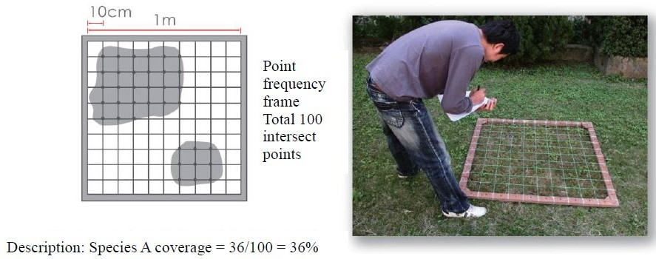
Quantitative survey of plant communities
The board frame used in point-intercept method (Source: Lin Xinhui, 2016)

Slide 64
Analysis and Application of Vegetation Data
Calculation of Importance and Diversity of Species
A. Calculation of important value index (IVI)
  The plant society parameter is expressed as important value index (IVI). The plant society is divided into upper and lower layers (the arbor layer and the ground cover layer), and the density, frequency and dominance of various plants in each sample area are calculated, and then converted into relative values.
  The important value of the upper layer plant society is the sum of the relative values of the three.
  The important value of the lower layer plant society is the sum of the relative frequency and relative dominance.

Slide 65
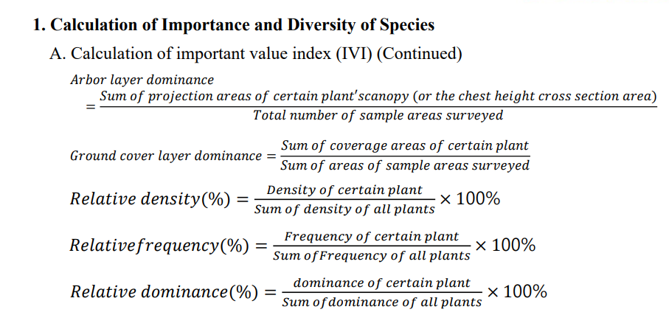
Analysis and Application of Vegetation Data

Slide 66
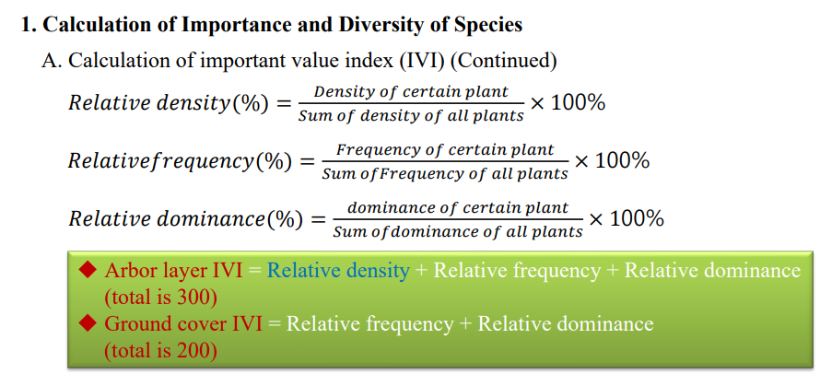
Analysis and Application of Vegetation Data

Slide 67
Analysis and Application of Vegetation Data
Calculation of Importance and Diversity of Species
A. Calculation of important value index (IVI) (Example)
Species | Number of plants | Relative Density(%) | Frequency | Relative Frequency(%) | Dominance (%) | Relative Dominance(%) | IVI
A | 2 | 4.00 | 2 | 5.41 | 10 | 10.00 | 19.41
B | 4 | 8.00 | 4 | 10.81 | 15 | 15.00 | 33.81
C | 15 | 30.00 | 8 | 21.62 | 22 | 22.00 | 73.62
D | 2 | 4.00 | 2 | 5.41 | 4 | 4.00 | 13.41
E | 2 | 4.00 | 2 | 5.41 | 5 | 5.00 | 14.41
F | 10 | 20.00 | 8 | 21.62 | 19 | 19.00 | 60.62
G | 11 | 22.00 | 8 | 21.62 | 20 | 20.00 | 63.62
H | 4 | 8.00 | 3 | 8.10 | 5 | 5.00 | 21.1
Sum | 50 | 100.00 | 37 | 100.00 | 100.00 | 100.00 | 300.00

Slide 68
Analysis and Application of Vegetation Data
1. Calculation of Importance and Diversity of Species
B. Calculation of species diversity index
For a plant society, if its constituent components are more complex, the more it can withstand the interference of external forces. Conversely, if the species of a plant community is quite simple, once the dominant plant species of the plant community suffers interference, then the impact on the whole plant community would be extremely serious. The complexity of a plant society is use species diversity index to express.

Slide 69
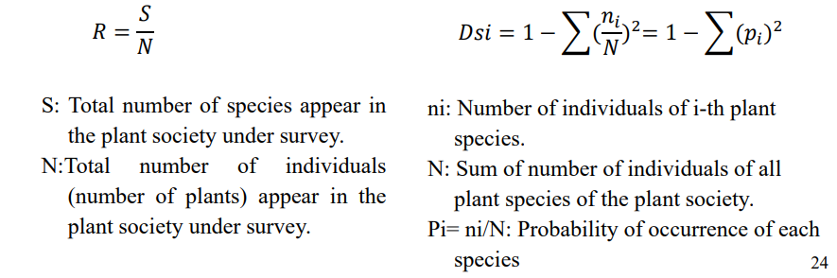
Analysis and Application of Vegetation Data
Calculation of Importance and Diversity of Species
B. Calculation of species diversity index (Continued)
  Species richness (R)  Simpson index of diversity (Dsi)

Slide 70
Analysis and Application of Vegetation Data
Analysis of Vegetation Communities
A. Vegetation community similarity
In order to compare the similarity of two plant communities, Motyka et al (1950) had used parameters such as species dominance to calculate Smo similarity index to compare two plant communities of the region.
𝑆𝑚𝑜 =
2Nw
×100%
𝑁𝑎+𝑁𝑏
Where
Na=Total number of individuals in the A sample area community Nb = Total number of individuals in the B sample area community
Nw = Sum of the fewer individuals in the common species of the two sample areas

Slide 71
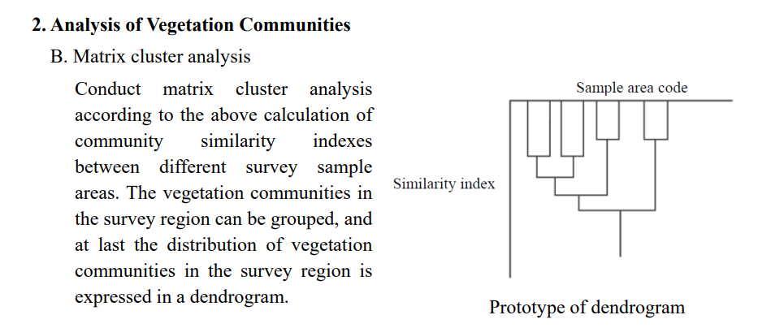
Analysis and Application of Vegetation Data

Slide 72
Analysis and Application of Vegetation Data
3. Normalized Difference Vegetation Index
Normalized Difference Vegetation Index (NDVI) is the ratio of the difference of near-infrared light band and red band to the sum of these two bands, can be used to judge the much or few of vegetation reflection amount and monitor vegetation changes. The calculation principle of normalized difference vegetation index is based on the characteristics that healthy green vegetation has strong reflection in near-infrared light and photosynthesis has strong absorption for red light. The formula is generally expressed as follows:
𝑁𝐼𝑅 − 𝑅
𝑁𝐷𝑉𝐼 = _{𝑁𝐼𝑅 + 𝑅}
Where
NIR: Near-infrared light reflection value R: Red light reflection value

Slide 73
Reference
Soil and Water Conservation Bureau (2017) Soil and Water Conservation Handbook (Agronomy Chapter ).

Slide 74

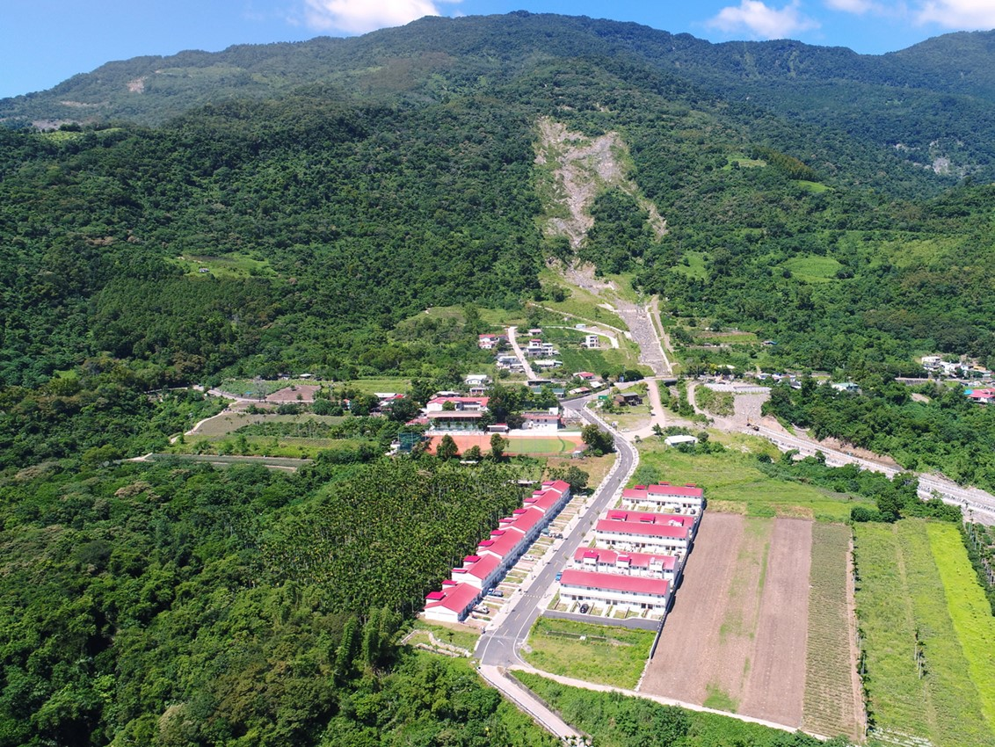



Soil and Water Conservation TAIWAN
Thank You

